Slide 1

Development of reverse genetic tools for wheat
Ksenia Krasileva
Group Leader EI/TSL
@kseniakrasileva
Cristobal Uauy
Group Leader JIC
@CristobalUauy
Wheat as a model organism, Dec 6th 2016

Slide 2




Reverse genetics in wheat: TILLING-by-sequencing
Krasileva et al, in review 2016

Slide 3
Most of the wheat genome is non-coding and repetitive
S.cerevisiae
A. thaliana
D. melanogaster
H. sapiens
T. turgidum
non-coding
repetitive
1-2% coding
non-coding
repetitive
coding
12 Mb
135 Mb
10x
180 Mb
15x
3.2 Gb
260x
12 Gb
1000x
1996
2000
2000
2001
2014
Notes:
Add year in which each genome was sequenced

Slide 4
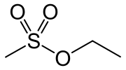
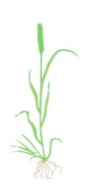
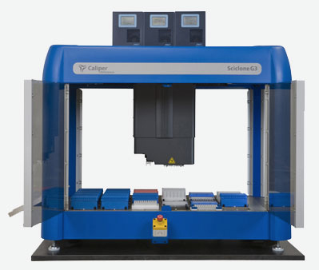

in silico TILLING workflow: Cadenza (6x) and Kronos (4x)
EMS treatment
Genomic DNA
Sheared DNA
M1
Barcoded library
M2
Exome capture
Genomic DNA
Illumina sequencing
ATGTTACT
CGTG
ATGCTGTT
AGTG
ATACTGCT
CGTG
ATGCTGCT
TATG
ATGCTGCT
CGTA
Over 3,000 lines and seed
Mutation identification
ATGTTACT
CGTG
ATGCTGTT
AGTG
ATACTGCT
CGTG
ATGCTGCT
TGTG
ATGCTGCT
CGTA
Krasileva et al Genome Biology 2013
Krasileva et al under review

Slide 5
Exome capture is extremely effective !
4-plex pooling = ~ 10 Gb per mutant (0.625 x whole genome coverage)
At least 60% of captured reads map are “on-target”
On-target Cov Per Base | % On-target Bases ≥ 1 x Cov | % On-target Bases ≥ 6 x Cov | % Genome Coverage Bases ≥ 1 x Cov | % Genome Coverage Bases ≥ 6 x Cov
45.51 x | 93.1 % | 85.8 % | 8.7 % | 1.6 %

Slide 6
Read alignment and mutation calling pipeline
sample
reads
+
genome reference
(Chinese Spring)
New software tools:
1. MAPS: Henry et al Plant Cell 2014
2. Polymarker: Ramirez-Gonzalez et al Bioinformatics 2015
BWA aln
aligned reads
Picard MarkDuplicates
duplicate reads removed
mutations called
MAPS
samtools view -f2
e! VEP
properly paired reads
mutations annotated
samtools view -L
Polymarker
reads on-target
mutations verified by KASP assays
On-target
coverage
assessed

Slide 7
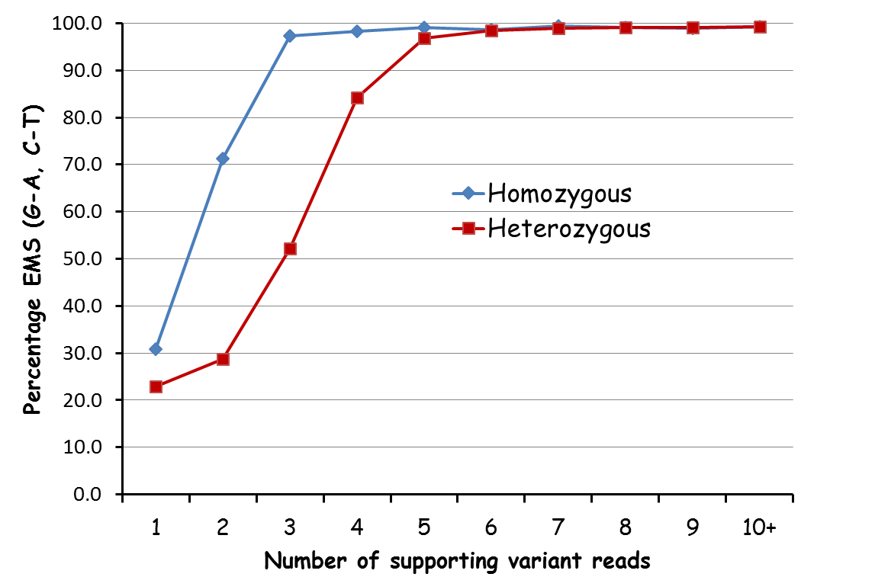
EMS mainly G>A and C>T transitions

Slide 8
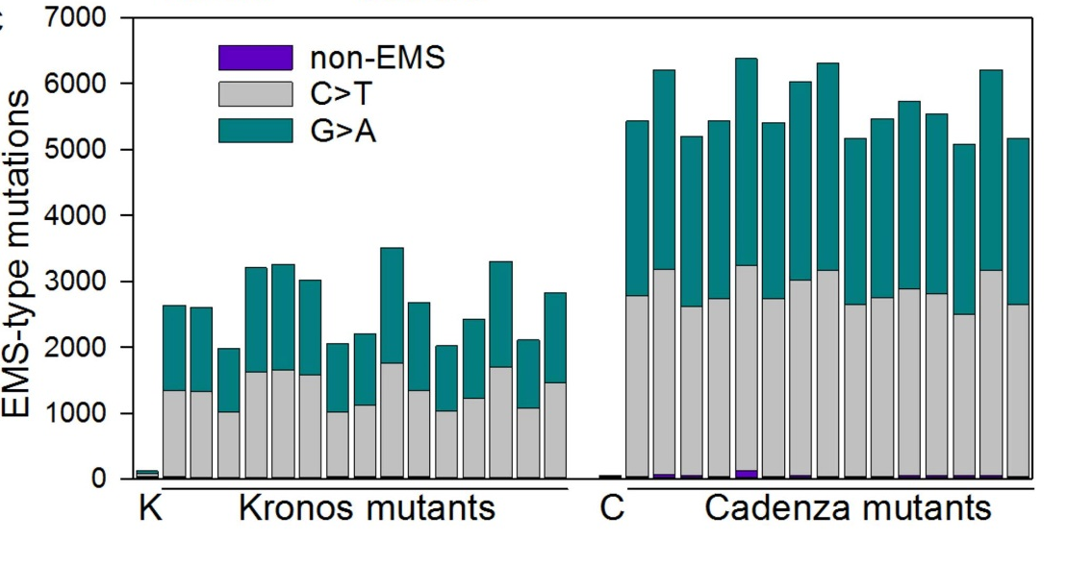
Distribution of mutations (subset)

Slide 9
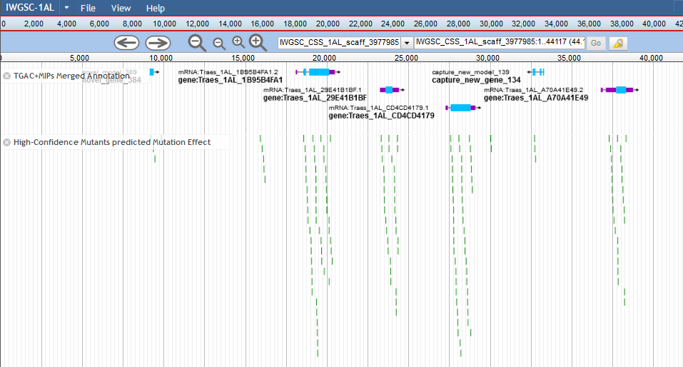
Genome Browser www.dubcovskylab.ucdavis.edu

Slide 10
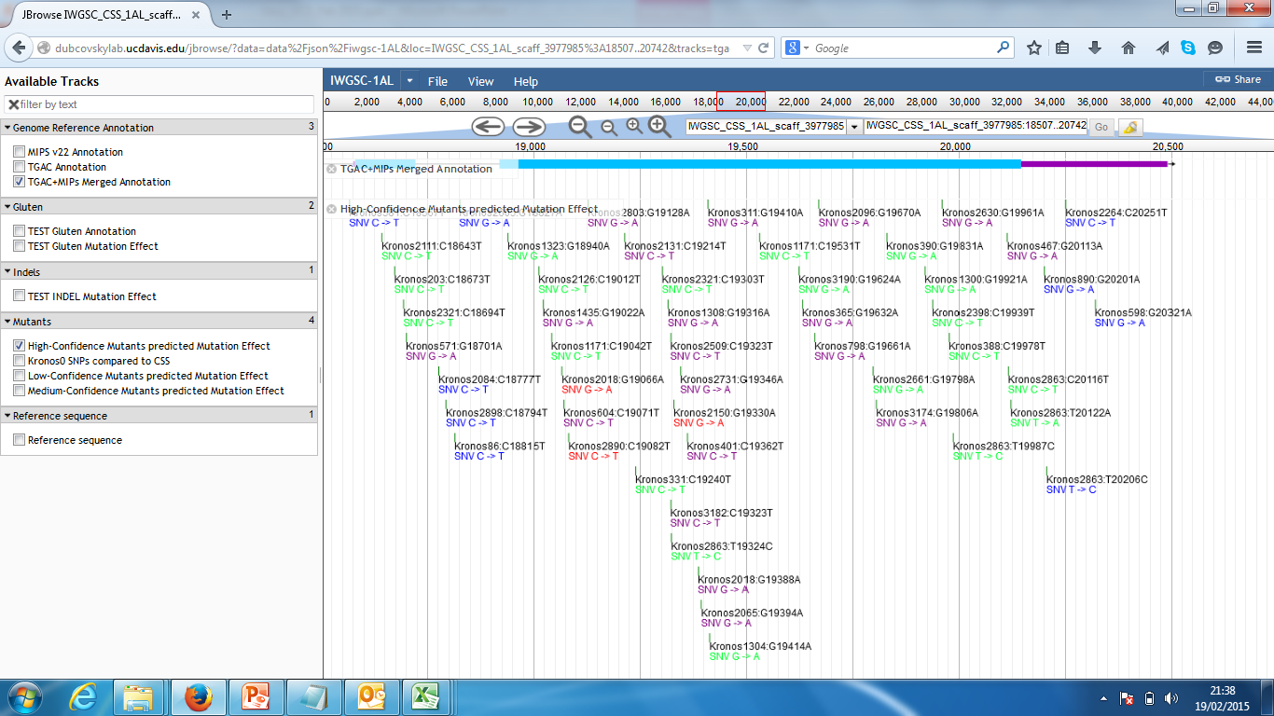
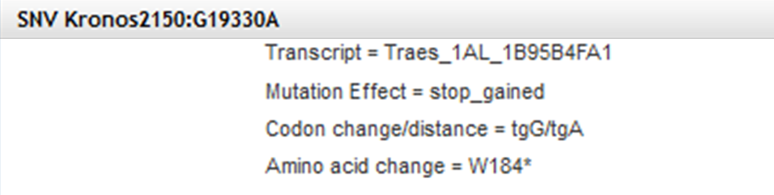
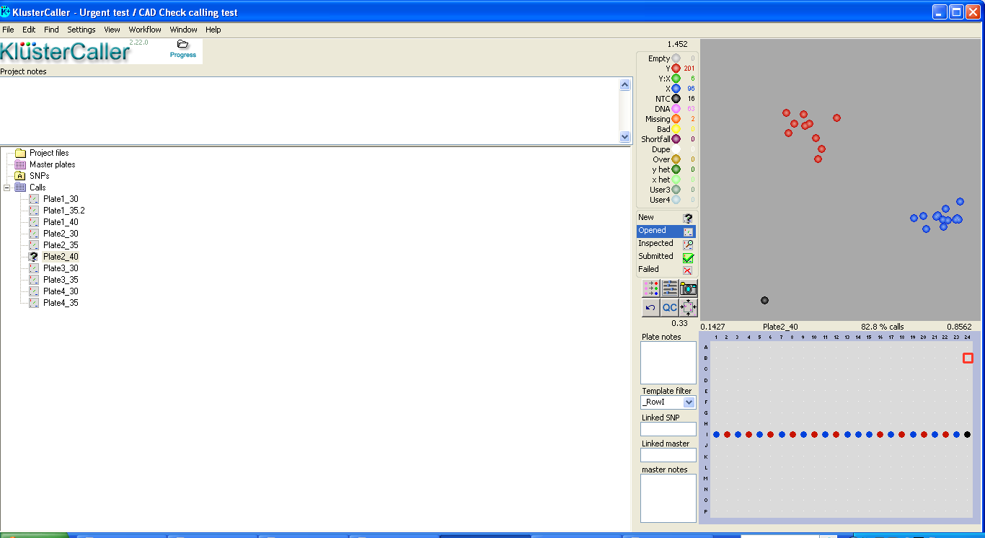

Genome Browser www.dubcovskylab.ucdavis.edu
Ramirez-Gonzalez et al Bioinformatics 2015

Slide 11
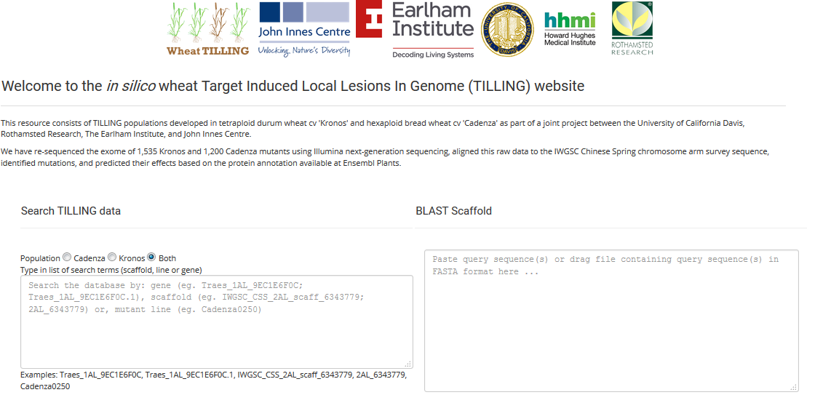
www.wheat-tilling.com
User: Triticum
Password: FiatLux

Slide 12
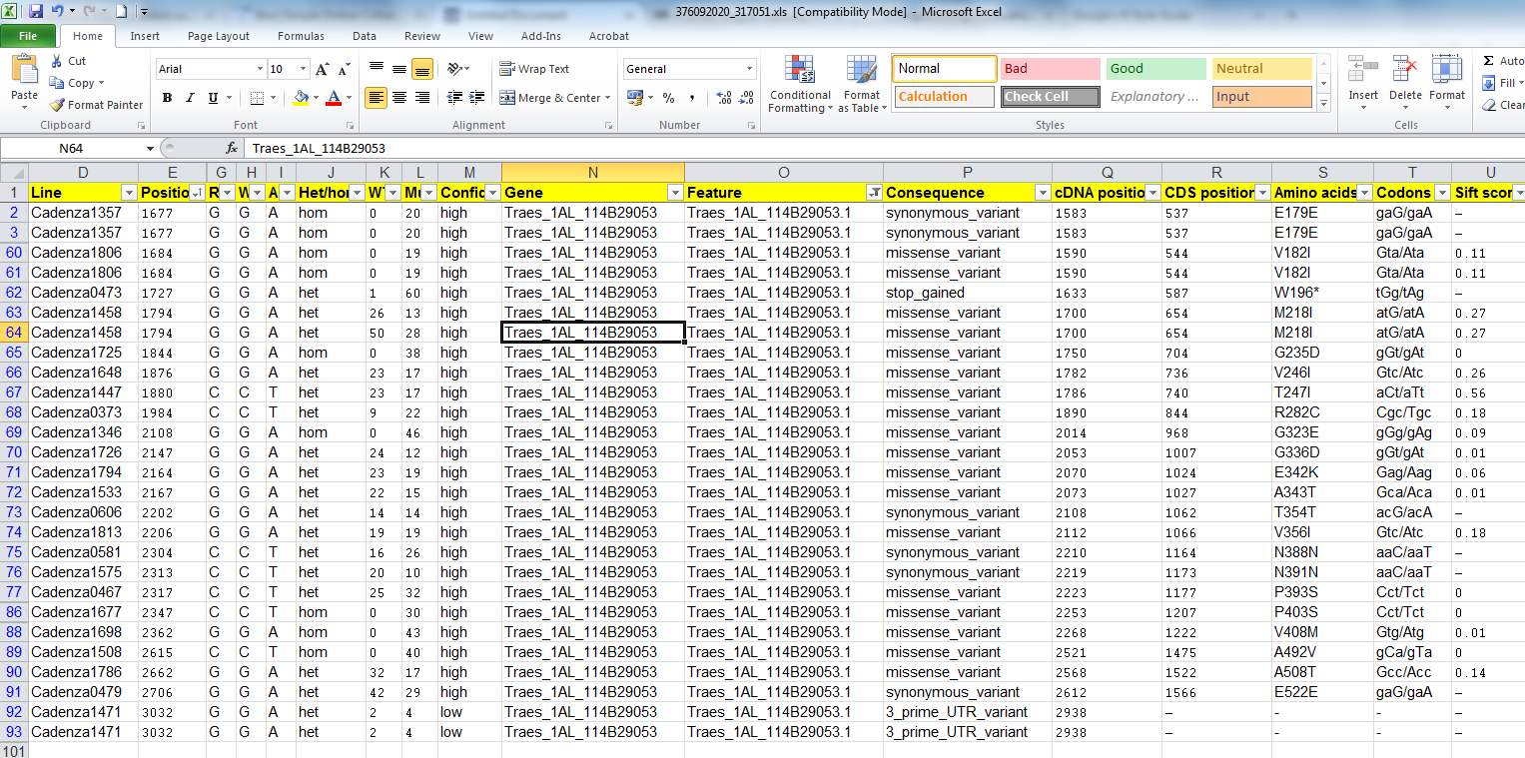
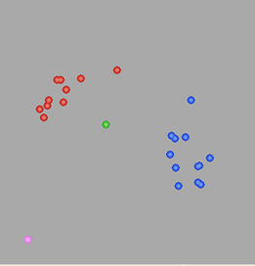
Example output (based on gene)

Slide 13
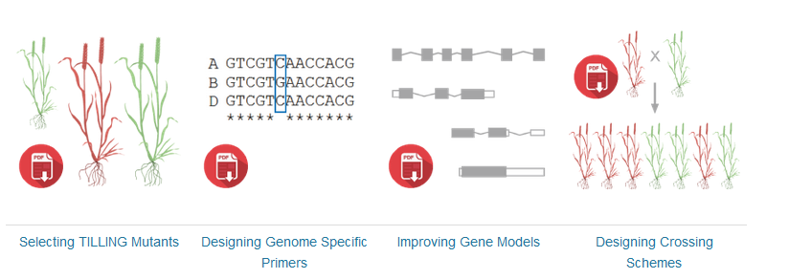
Column name | Description
Scaffold | This is the name of the IWGSC CSS scaffold using the EnsemblPlants nomenclature. The name has a hyperlink to the actual FASTA sequence of the scaffold which allows users to identify the position within the genomic DNA context.
Chr | This indicates to which chromosome an IWGSC scaffold is assigned to and is a useful filtering feature.
Line | Name of the mutant line, which consists of the name of the mutant population (Cadenza or Kronos) and a four digit number (e.g Cadenza1574).
Category | EMS mutations were classified according to different categories which are detailed in section 4a.
Position | The position of the SNP relative to the start of the respective IWGSC scaffold. The actual FASTA sequence is available through the hyperlink in the scaffold name (Column 1)
Chromosome position | The position of the SNP relative to the chromosome pseudomolecules hosted at EnsemblPlants (Release 27)
Rf | Reference: This is the base call at the position in the reference genome of Chinese Spring (CS) published by the IWGSC.
wt | Wildtype: This is the base call at the particular position in a non-mutagenized Wild Type control of either the hexaploid variety Cadenza or the tetraploid variety Kronos.
mt | Mutant: This is the base call at the position in the EMS-mutagenized individual from either the hexaploid variety Cadenza or the tetraploid variety Kronos.
Het/hom | Classification of the individual as heterozygous or homozygous for the mutant allele. If the wildtype coverage (WT_cov) is 0 or <15% of the total reads then the SNP is called as homozygous mutant. Otherwise the SNP is called as heterozygous.
WT cov | Wild type coverage: Number of reads with the Wild type allele at the position.
Mut cov | Mutant coverage: Number of reads with the Mutant allele at the position.
Gene | This is the name of the IWGSC gene model that is present on the IWGSC scaffold. More than one gene can be present on a single scaffold. The “.X” ending refers to the transcript variant which was used to predict the effect of the mutation. The gene name is hyperlinked to the EnsemblPlants gene page.
Consequence | Consequence of the mutation on the transcript as predicted by the Variant Effect Predictor (VEP) tool from Ensembl based on the IWGSC gene model. A full detail of the different effects predicted is described in VEP
cDNA pos | Position of the mutation relative to the cDNA of the predicted IWGSC gene model.
CDS pos | Position of the mutation relative to the coding sequence (CDS) of the predicted IWGSC gene model.
Amino acids | Indicates whether a mutation leads to the change of an amino acid in the translated protein of the predicted gene model. For UTR, intron and synonymous variants this value is empty; for non-synonymous mutations the amino acids encoded by the wild type and mutant alleles are shown. For example a value of “P/L” means that the wild type codon encoding for a proline (P) residue was mutated to a codon encoding for a Leucine (L) residue.
Codons | Sequence of the wild type / mutant codon in the mutant line. The uppercase letter indicates the base which was mutated. For example, cCa/cTa corresponds to a mutation in the middle position of the CCA codon (P) which was mutated to a CTA codon (L).
Sift score | Sorting Intolerant From Tolerant (SIFT) probability score that that the amino acid change is tolerated. Scores <0.05 are considered deleterious whereas all others are considered tolerated. SIFT was implemented through Ensembl VEP as described in Krasileva et al; Materials and Methods section 3.6.
Primer type | The predicted specificity of the designed KASP assays according to its ability to preferentially amplify a single target genome (specific), discriminate against at least one alternative genome (semi-specific) or not able to discriminate and hence amplifying all genomes or paralogues of the gene (non-specific). Specific and semi-specific assays are preferred where possible for downstream validation of the mutation. Primer were designed using http://polymarker.tgac.ac.uk/ (Ramirez-Gonzalez et al 2015).
Orientation | Plus (+) or minus (-) according to the strand orientation of wild type and alternative primers on the IWGSC scaffold (column 1) sequence.
WT primer* | Sequence of the wild type primer. Uppercase bases within the primer sequence correspond to genome specific SNPs, whereas the 3’ uppercase base corresponds to the target EMS SNP.
Alt primer* | Sequence of the alternative primer which amplifies the mutant allele.
Common | Common primer sequence for the KASP assay
http://www.wheat-training.com/wp-content/uploads/TILLING/pdfs/Selecting-TILLING-mutants.pdf
http://www.wheat-training.com/wp-content/uploads/TILLING/pdfs/Selecting-TILLING-mutants.pdf

Slide 14

Summary
 | Tetraploid Kronos | Hexaploid Cadenza
Uniquely mapped SNPs | 4,189,561 | 6,470,733
Heterozygous / Homozygous ratio at M₂ | 1.87 | 2.21
Uniquely mapped EMS-type mutations | 4,152,707 | 6,421,522
Avg. EMS-type mutations/line | 2,705 | 5,351
Avg. EMS-type mutations per kb (population) | 34.8 | 39.5
% EMS-type | 99.1% | 99.2%

Slide 15
Summary
 | Tetraploid Kronos | Hexaploid Cadenza
Gene models with at least one mutation (GM₁) | 48,172 | 73,895
GM₁ with at least one truncation | 28,604 (59%) | 45,311 (61%)
GM₁ with at least one missense mutation | 46,198 (96%) | 69,543 (94%)
Avg. number of missense mutations per GM₁ | 21.4 | 22.6
GM₁ with truncation and/or deleterious missense | 43,787 (91%) | 67,830 (92%)
No. of unique genes eliminated in large deletions | 832 | 6,657
splice_donor_variant | 15,074 | 26,783
splice_acceptor_variant | 14,624 | 20,889
stop_gained | 46,580 | 85,985
initiator_codon_variant | 943 | 1,953
missense_variant | 1,030,287 | 1,668,693

Slide 16
Lower confidence
Coverage | # SNPs | Het/Hom | EMS SNP | Avg. EMS SNP / line | %EMS | non-EMS transitions | %EMS error
Kronos
HetMC3/HomMC2 | 5,525,228 | 2.46 | 5,085,379 | 3,313 | 92.04 | 35,707 | 0.70
HetMC4/HomMC3 | 4,601,287 | 2.15 | 4,507,550 | 2,937 | 97.96 | 12,525 | 0.28
HetMC5/HomMC3 | 4,189,561 | 1.87 | 4,152,707 | 2,705 | 99.12 | 7,323 | 0.18
Cadenza
HetMC3/HomMC2 | 8,599,721 | 2.85 | 8,083,066 | 6,736 | 93.99 | 108,261 | 1.34
HetMC4/HomMC3 | 7,203,110 | 2.58 | 7,054,109 | 5,878 | 97.93 | 29,019 | 0.41
HetMC5/HomMC3 | 6,470,733 | 2.21 | 6,421,522 | 5,351 | 99.24 | 10,569 | 0.16

Slide 17
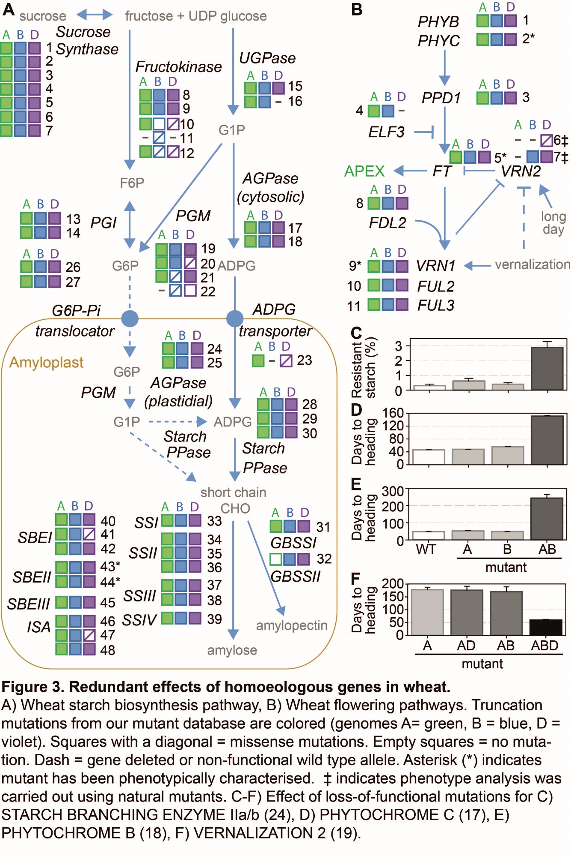

Over 10M mutations in wheat
Eliminate protein or alter function in >90% of wheat genes
Open access searchable database
Seeds free of IP
Brittany Hazzard

Slide 18
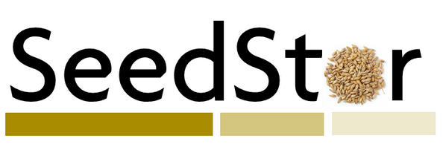
Access to mutants
Databases of mutations are available at
www.wheat-tilling.com
www.dubcovskylab.ucdavis.edu
http://pre-test.plants.ensembl.org/index.html
We hold mirror collection of seeds at UC Davis and JIC Seed Store (seedstor.ac.uk)
Mutants will be free from any IP for the mutations people find
£15 for non-commercial use
£200 for commercial use(freedom to operate)
https://www.seedstor.ac.uk/

Slide 19
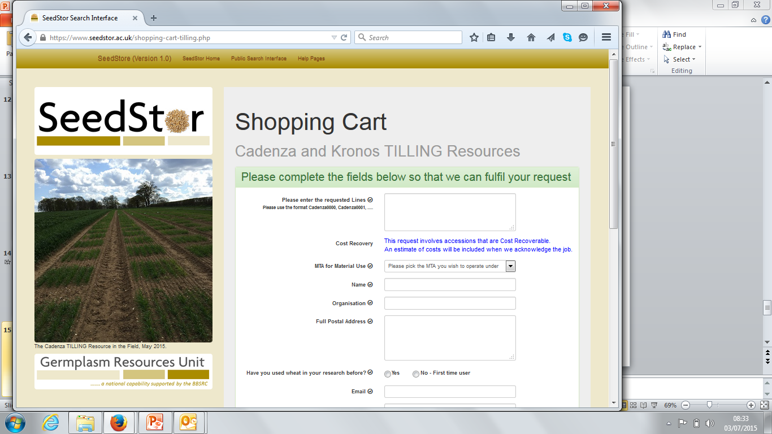
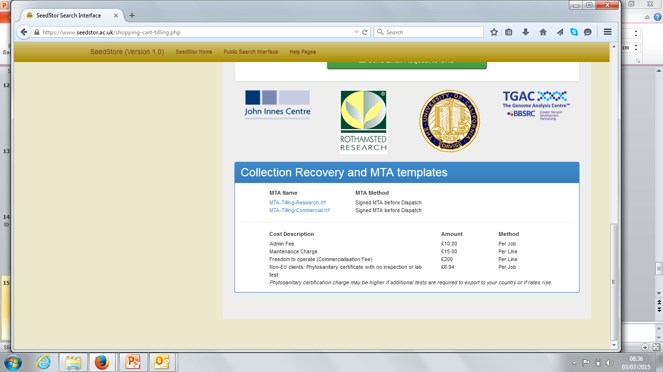
Standard phytosanitary also available. Useful for most countries

Slide 20
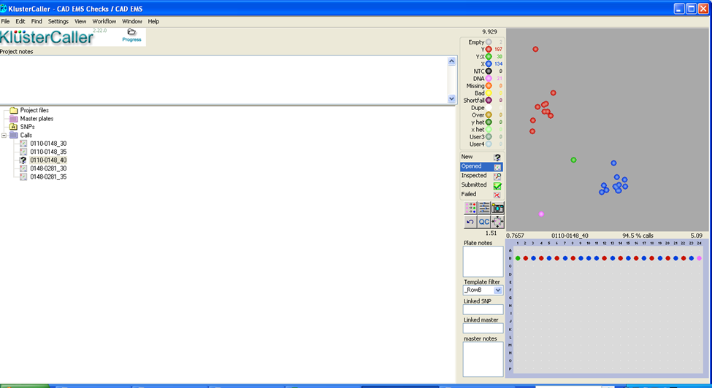
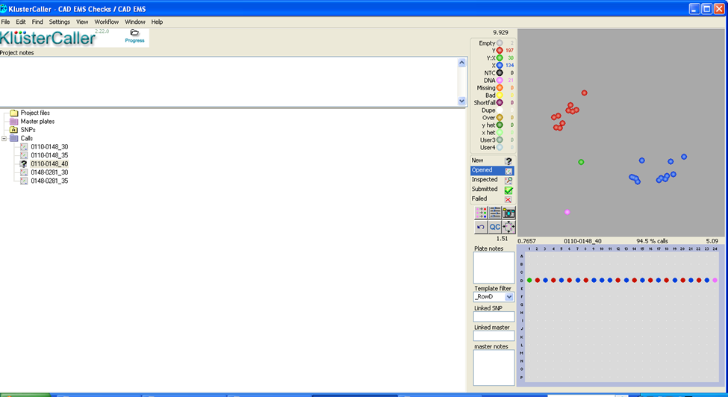
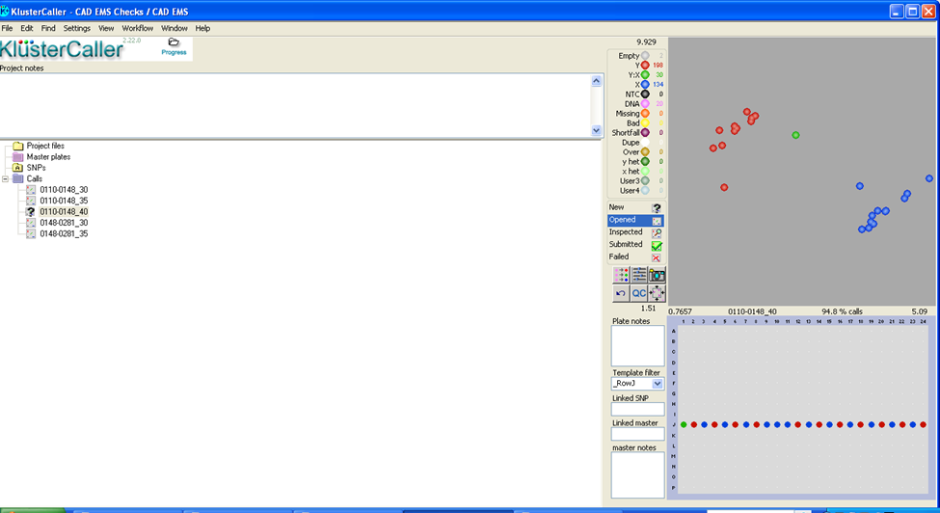
Validation of SNPs with KASP markers
PolyMarker assays worked first time for 85% of the SNPs.
 | Kronos |  |  | Cadenza
 | No. | % |  | No. | %
Independent M₄ families tested | 67 |  |  | 19
Valid KASP assays and Sanger sequence | 133 |  |  | 147
False positives | 1 | 0.7% |  | 1 | 0.7%
Mutations confirmed | 132 | 99.2% |  | 146 | 99.3%
Expected segregation (MAPS with correction¹) | 130 | 98.5% |  | 139 | 95.2%
HOM mutation originally classified as HET | 2 | 1.5% |  | 2 | 1.4%
HET mutation originally classified as HOM² | 0 | 0.0% |  | 5 | 3.4%

Slide 21
Potential issues
Het:Hom calls
Residual heterogeneity
Blindspots
Missing homoeologue
Mis-annotation of gene model

Slide 22
Het:Hom calls

Slide 23
In the full sight: We detect residual heterogeneity within populations

Slide 24
Residual heterogeneity in Kronos population

Slide 25
Blindspots: assembly redundancies and copy number variants
Contig1 is 100% identical to region in contig 2
contig1
contig2
Non-unique mapping
of the reads
Mapping quality = 0
Our threshold for calling mutations is 20

Slide 26
Current solution: masking
Contig1 is 100% identical to region in contig 2
contig1
XXXXXXXXXXXX
contig2
Non-unique mapping
of the reads
This mutation can also be at contig1

Slide 27
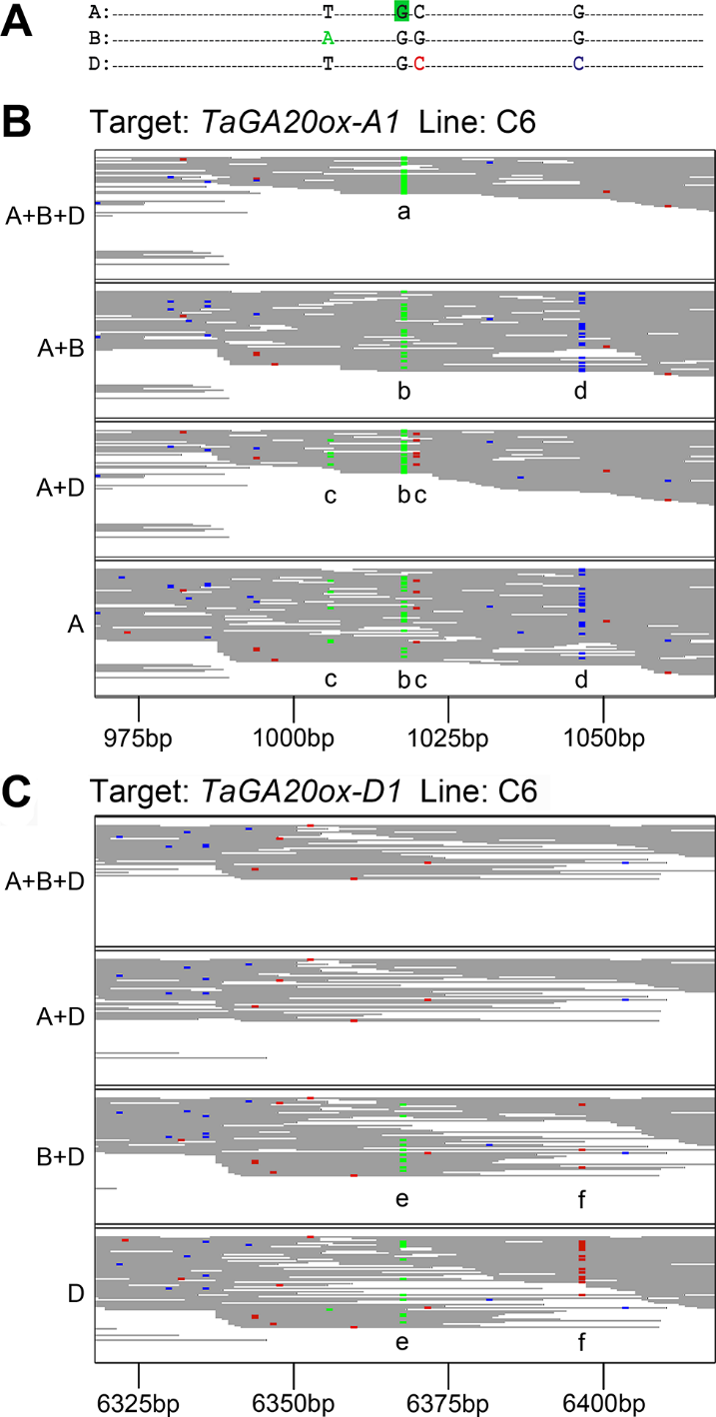
Missing Homoeologue
Mis-mapped reads from D dilute homozygous mutation in A
Two possible mistakes:
HET v HOM
Incorrect genome
King et al Plos One 2015

Slide 28
Mis-annotation of gene model
Predictions on putative effects are based on gene model.
If gene model missing: mutations called as inter-genic variants
If gene model is incorrect: our variant effect prediction will also be incorrect.
http://www.wheat-training.com/wp-content/uploads/TILLING/pdfs/Improving-Gene-models.pdf

Slide 29
Selecting mutations to take forward
Type of mutation (truncation, position, SIFT (!))
Zygocity
Population (4x vs 6x)
Evidence (coverage)
http://www.wheat-training.com/wp-content/uploads/TILLING/pdfs/Selecting-TILLING-mutants.pdf

Slide 30
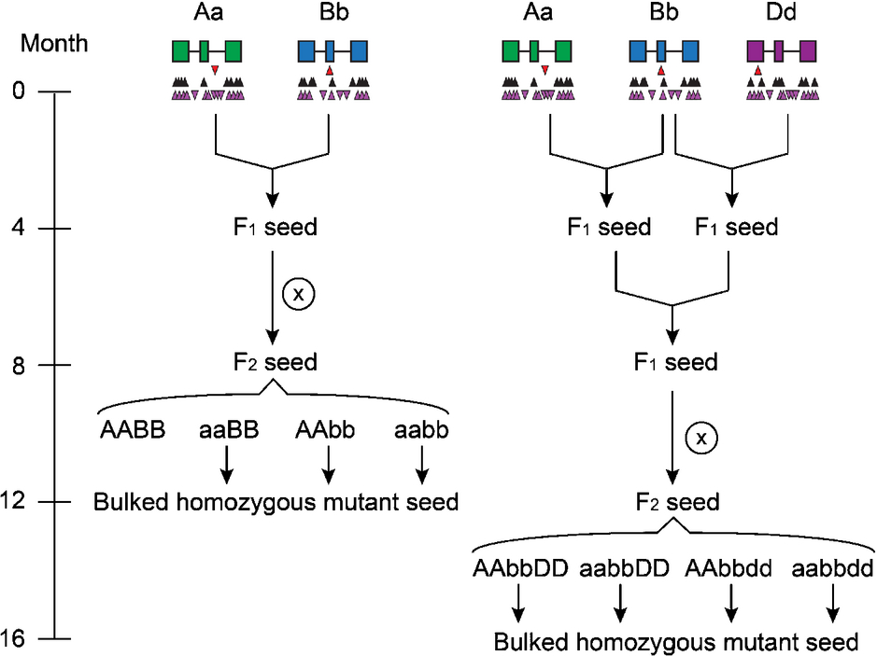
Combining mutations
Simple scheme

Slide 31
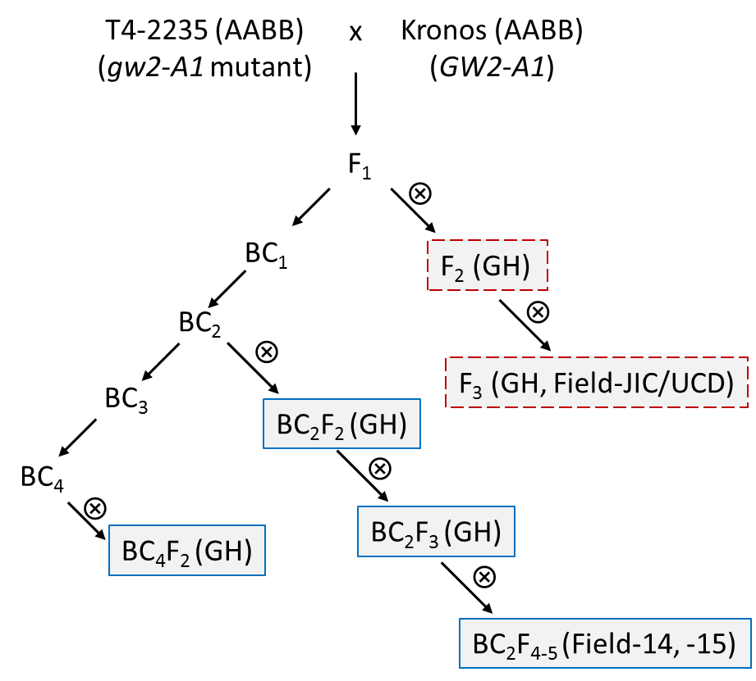
Combining mutations
More complex phenotype (backcrossing to dilute ~500,000 background mutations)

Slide 32
Combining mutations
More details online
http://www.wheat-training.com/wp-content/uploads/TILLING/pdfs/Designing-crossing-schemes.pdf

Slide 33
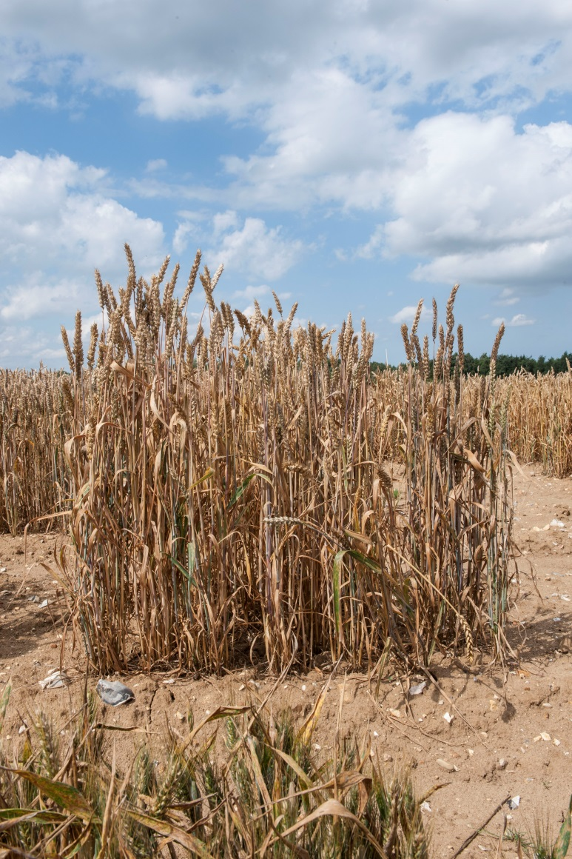
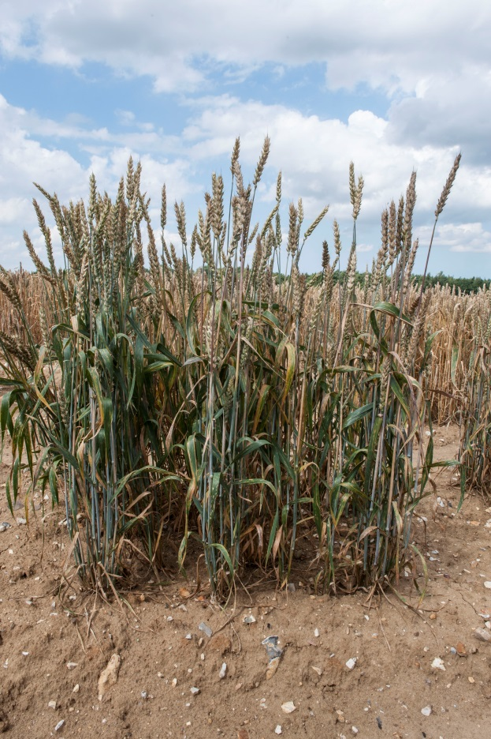
Dosage of quantitative trait: Grain Protein Content (GPC) example
Uauy et al Science 2006; Avni et al Planta 2014; Uauy/Borrill unpub.

Slide 34
Dosage of quantitative trait: amylose content
double mutants
SBEIIa
Amylose (% wild type)
single mutants
Waxy
double mutants
Amylose (% wild type)
Borrill, Adamski & Uauy (2015)
New Phytologist

Slide 35
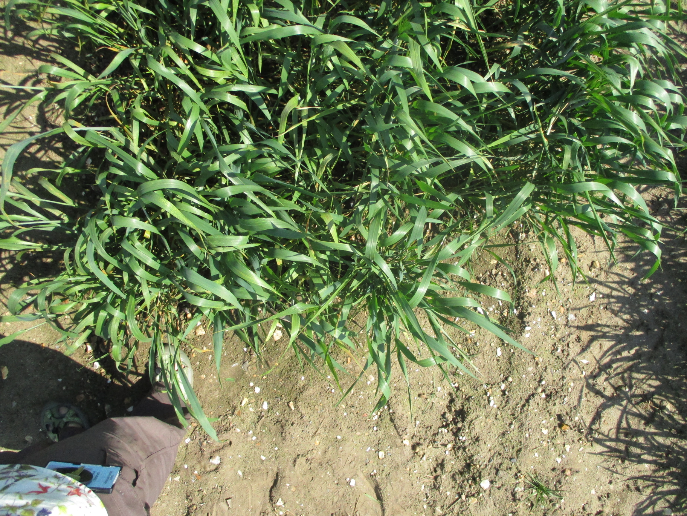
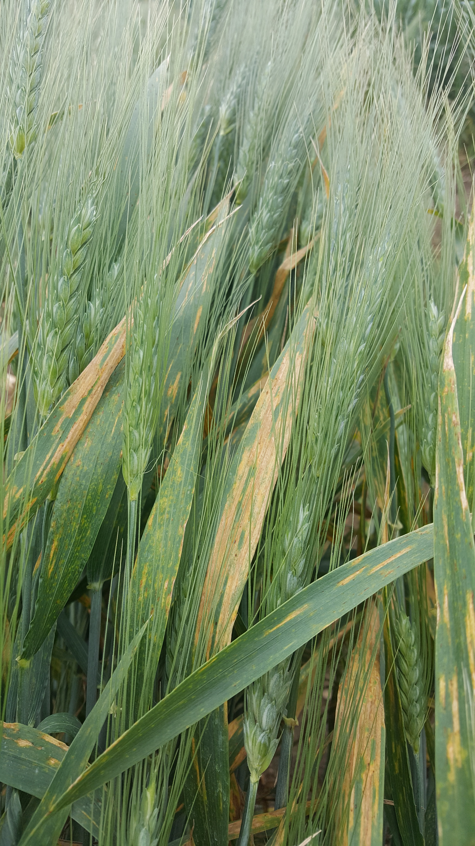
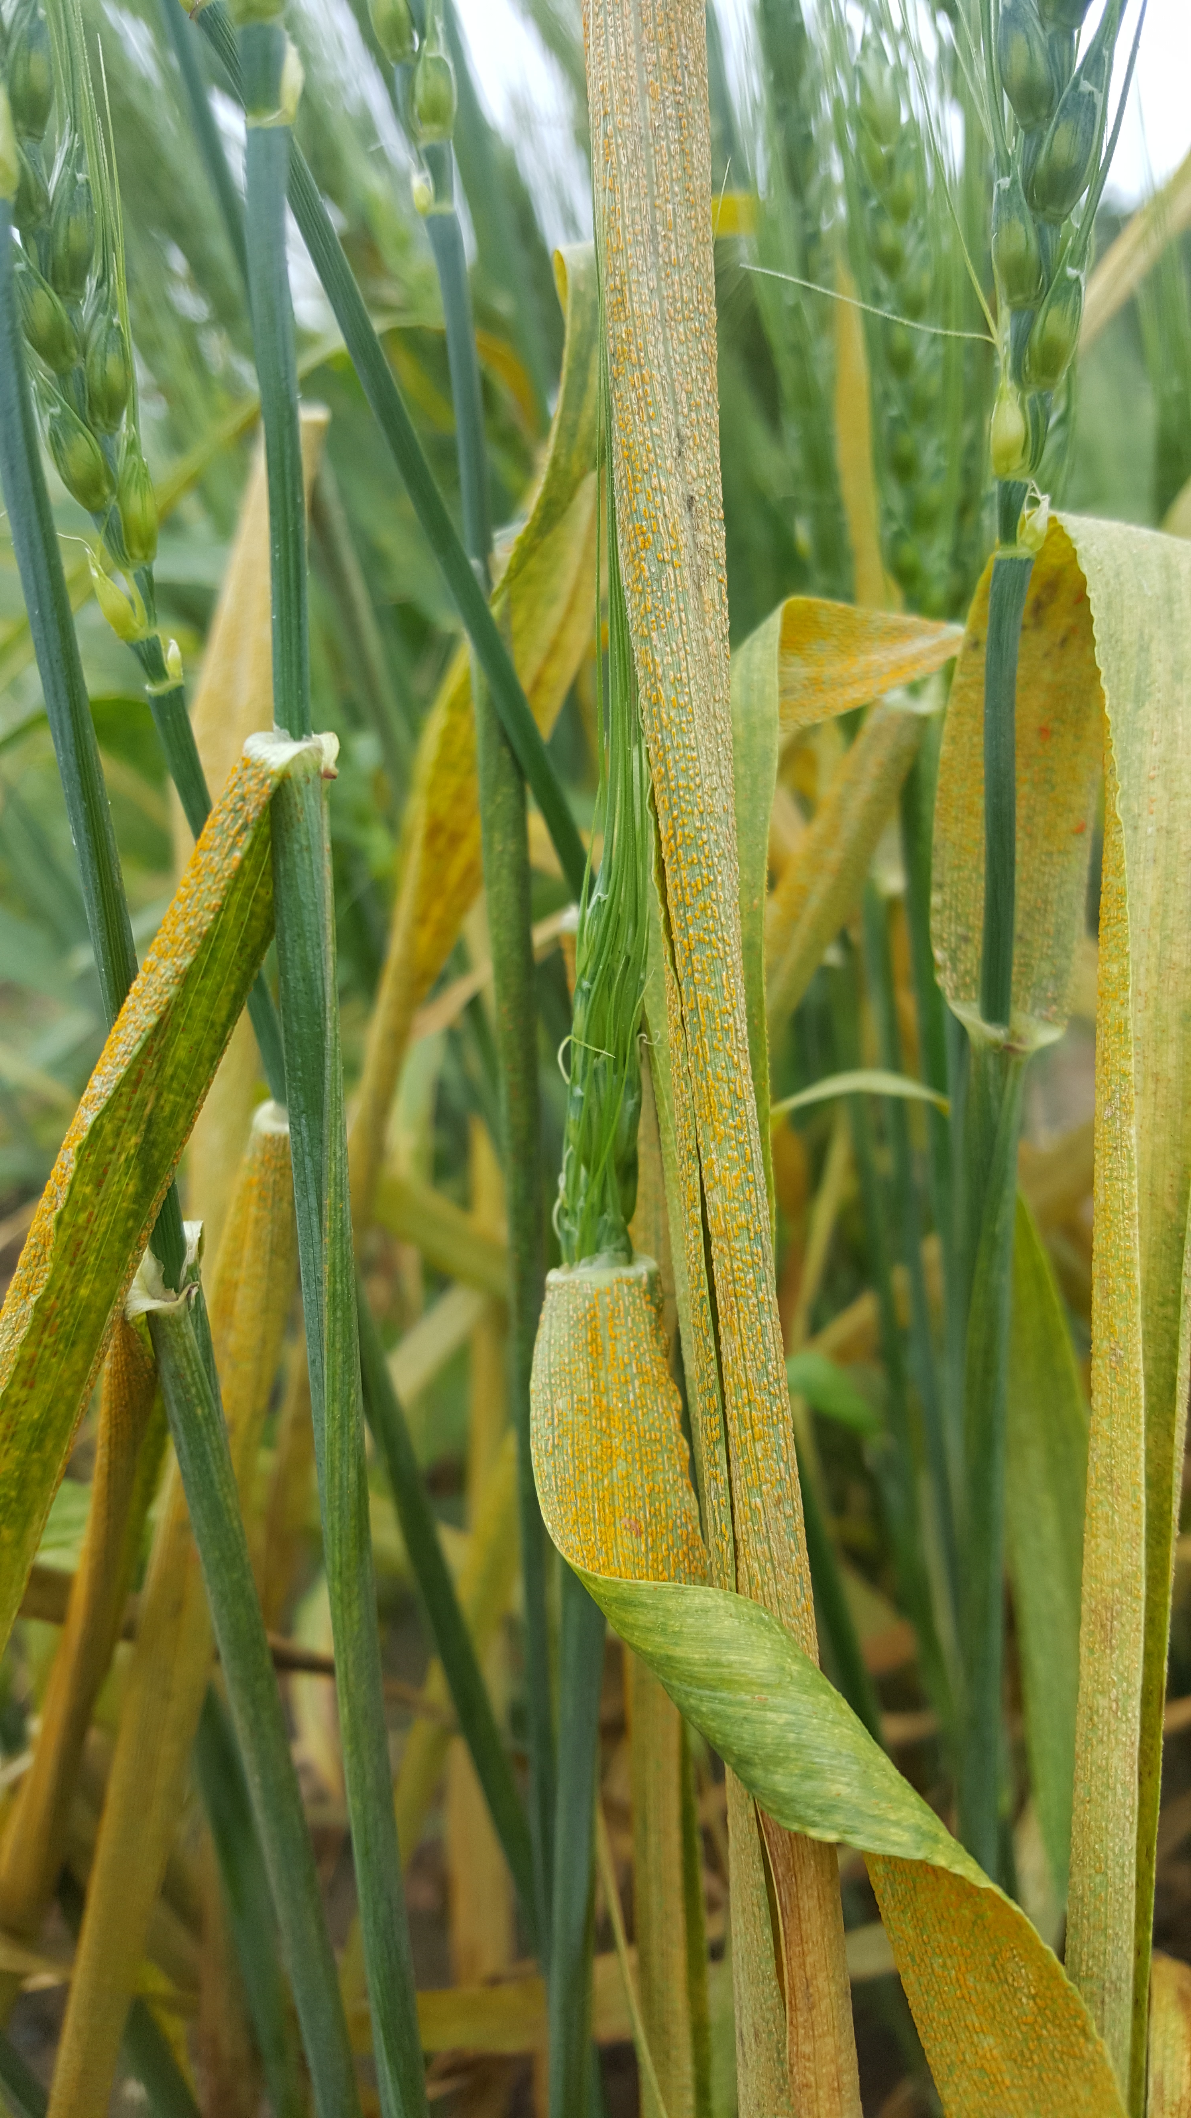
Dominant gain-of-function mutations: disease resistance
Mutant
Resistant
WT
Partially Resistant
Susceptible
Raats/Hegarty, Deatker, Schudoma, Dubcovsky and Krasileva, unpublished

Slide 36




Rothamsted
Andy Phillips
Robert King
The team
Krasileva Group (EI/TSL)
Paul Bailey (EI)
Dina Raats (EI)
Christian Schudoma (EI)
Francesca Stefanato (TSL)
Andrew Deatker (TSL)
EI
Platforms and pipelines
High Performance Computing
Leah Clissold
Christine Fosker
Sarah Ayling
John Innes Centre
Cristobal Uauy
James Simmonds
Philippa Borrill
Ricardo Ramirez-Gonzalez
UC Davis
Jorge Dubcovsky
Hans Vasquez-Gross
Tyson Howell
Francine Paraiso
Joshua Hegarty
Xiaodong Wang
EBI
Paul Kersey
Dan Bolser
Guy Naamati
International Wheat Genome Consortium
Our funding

